Slide 1



AtliQ Hardware
Consumer Goods
Ad-Hoc Insights
Presented By : Ayush Dongre

Slide 2

Content
1) Company Overview
2) Problem Statement
3) Dataset and Model
4) Ad-hoc Requests, Outputs, and Insights
5) Recommendations

Slide 3


Company Overview
AtliQ Hardware is a leading producer of computer hardware in India, with a significant presence in international markets.

Slide 4
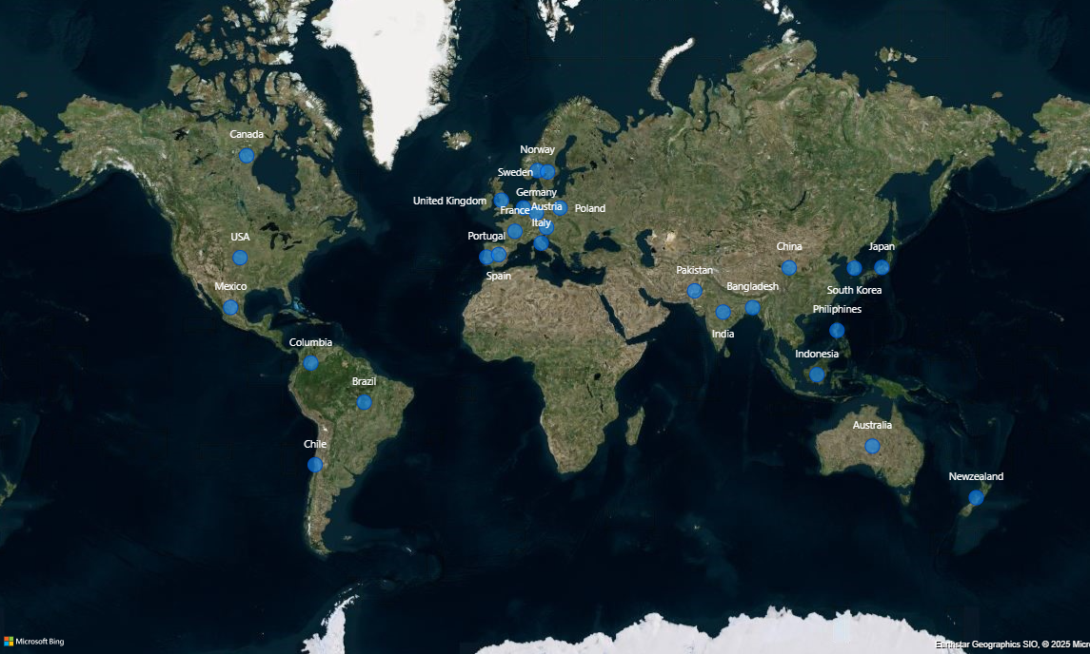

Markets

Slide 5
Product Line
PC
P&A
N&S
Desktop
Notebook
Peripherals
Accessories
Networking
Storage
Business Laptop
Gaming
Laptop
Graphic Card
Batteries
Wi Fi
Extender
External SSD
Personal Laptop
Business Laptop
Interna
HDD
Keyboard
USB Flash Drives
Personal Laptop
Motherboard
Mouse
Processors

Slide 6

Problem Statement
Management identified a gap in actionable insights required for quick, informed decision-making. As a solution, the team decided to expand the data analytics department by hiring junior analysts.
Tony Sharma, Director of Data Analytics, prioritized candidates with strong technical expertise and communication skills. To assess their capabilities, he designed a comprehensive SQL challenge.

Slide 7
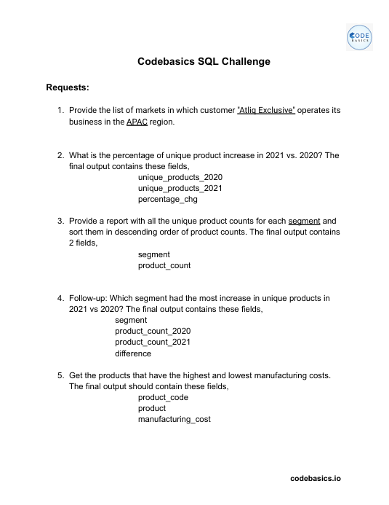
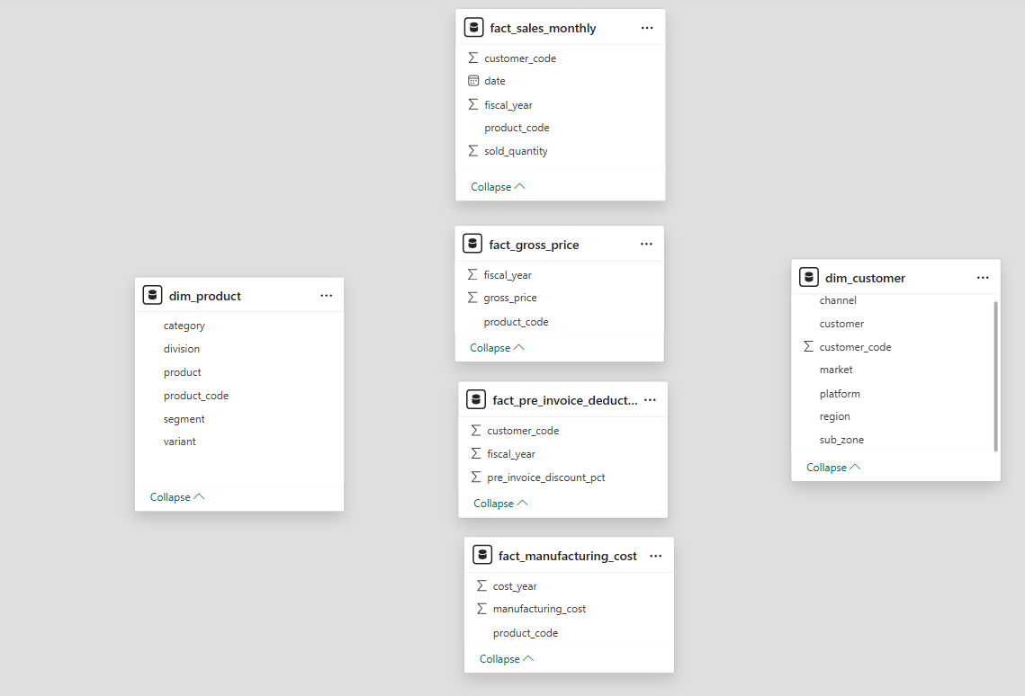
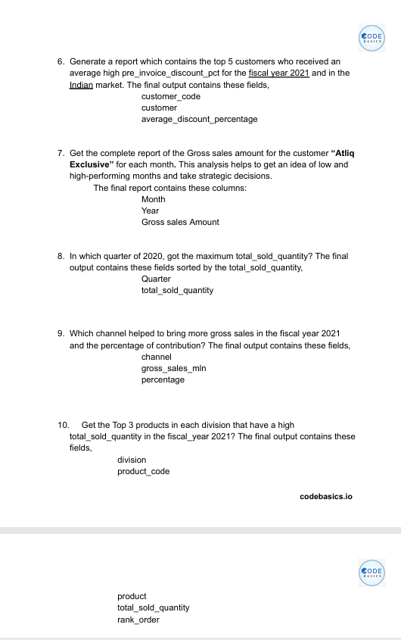
Data Set

Slide 8
Ad-hoc Requests, Outputs, and Insights
Request 1
Provide the list of markets in which customer "AtliQ Exclusive" operates its business in the APAC region.
Input
SELECT
distinct(market)
FROM dim_customer
WHERE customer = "Atliq Exclusive"
AND region=“ APAC“ ;

Slide 9
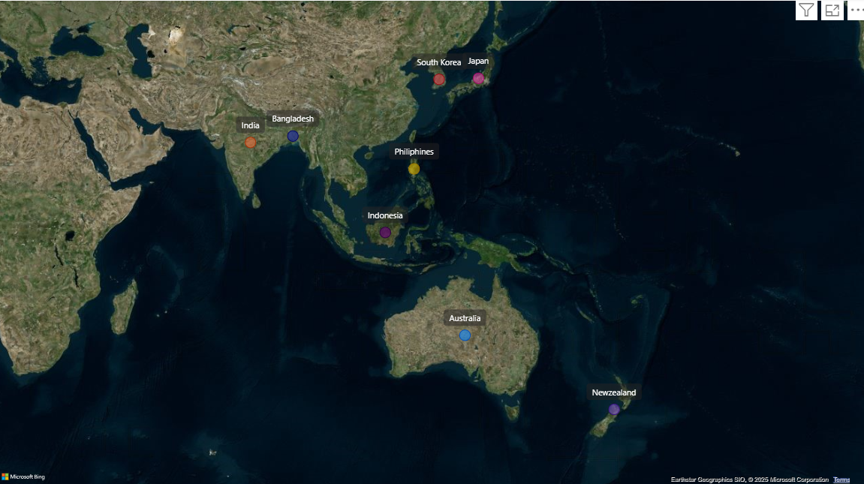
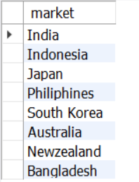

Output
Insight :
AtliQ Exclusive has a strong foothold in the APAC region, operating across eight countries and establishing itself as a prominent player in the market.

Slide 10
Request 2
What is the percentage of unique product increase in 2021 vs. 2020?
Input
WITH unique_products_2020 AS (SELECT COUNT(DISTINCT(product_code)) AS unique_products_2020
FROM fact_gross_price
WHERE fiscal_year=2020),
unique_products_2021 AS (SELECT COUNT(DISTINCT(product_code)) AS unique_products_2021
FROM fact_gross_price
WHERE fiscal_year=2021)
SELECT *,
ROUND((unique_products_2021-unique_products_2020)*100/unique_products_2020,2) AS pct_increase FROM unique_products_2020CROSS
JOIN unique_products_2021 ;

Slide 11
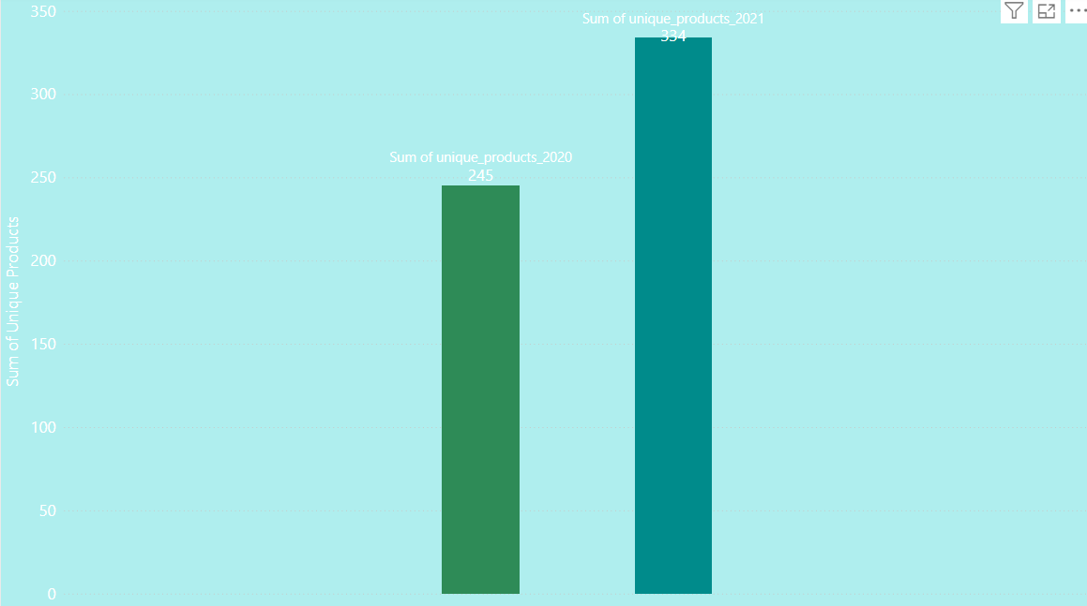
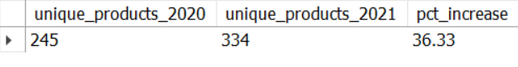
Output
Insight :
The count of unique products rose from 245 in 2020 to 334 in 2021, reflecting a growth of 36.33%.
This notable growth highlights the company's commitment to innovation and addressing a diverse range of customer needs.

Slide 12
Request 3
Provide a report with all the unique product counts for each segment and sort them in descending order of product counts.
Input
SELECT segment,
COUNT(DISTINCT(product_code)) AS product_count FROM dim_product
GROUP BY segment
ORDER BY product_count DESC;

Slide 13
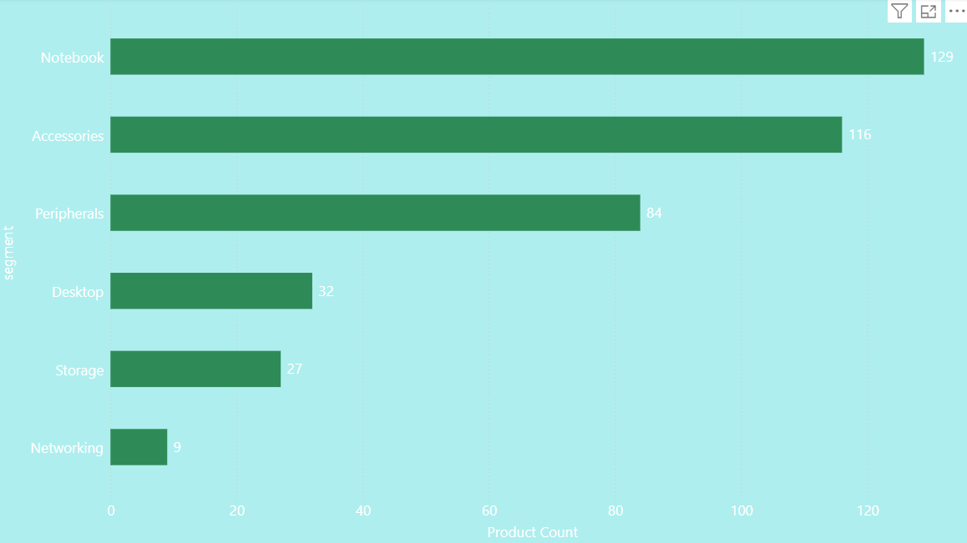
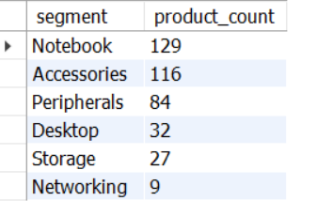
Output
Insight :
AtliQ excels in the Notebooks, Accessories, and Peripherals segment, contributing an impressive 82.87% to the product variety.
In the Desktops, Storage, and Networking segment, AtliQ should prioritize products that align with evolving customer preferences and market trends.

Slide 14
Request 4
Follow-up: Which segment had the most increase in unique products in 2021 vs 2020?
Input
WITH products_2020 AS ( SELECT p.segment,
COUNT(DISTINCT g.product_code) AS product_count_20
FROM dim_product p
JOIN fact_gross_price g
ON p.product_code = g.product_code
WHERE g.fiscal_year = 2020
GROUP BY p.segment),
products_2021 AS ( SELECT a.segment,
COUNT(DISTINCT b.product_code) AS product_count_21
FROM dim_product a
JOIN fact_gross_price b
ON a.product_code = b.product_code
WHERE b.fiscal_year = 2021
GROUP BY a.segment)
SELECT c.segment, c.product_count_20, d.product_count_21,
d.product_count_21 - c.product_count_20 AS difference
FROM products_2020 c
JOIN products_2021 d ON c.segment = d.segment
ORDER BY difference DESC;

Slide 15
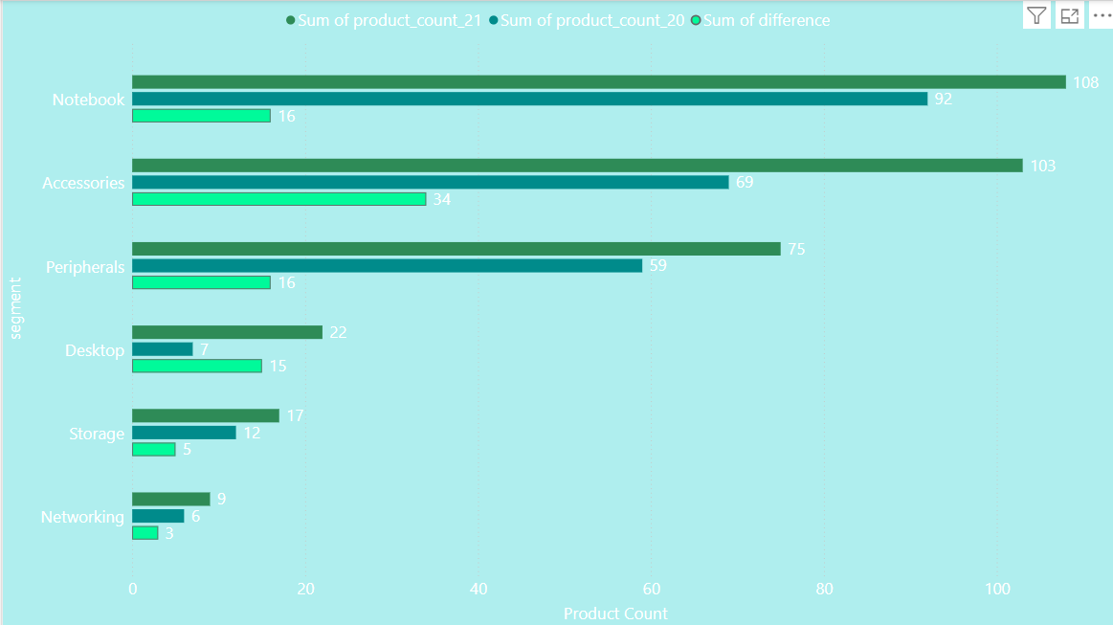
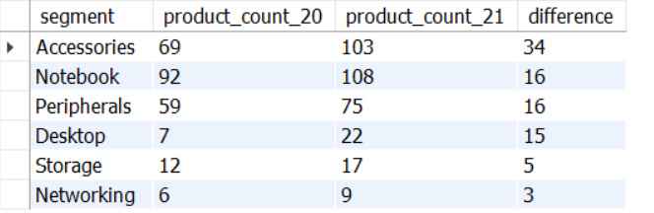
Output
Insight :
Accessories experienced the highest growth in product additions from 2020 to 2021, with 34 new products introduced.
Desktop product production saw a remarkable surge, growing by approximately 214% during the same period.
The Storage and Networking segments showed the lowest increase in new product production between 2020 and 2021.

Slide 16
Request 5
Get the products that have the highest and lowest manufacturing costs.
Input
SELECT p.product_code,
p.product,
m.manufacturing_cost
FROM dim_product p
JOIN fact_manufacturing_cost m
ON p.product_code=m.product_code
WHERE m.manufacturing_cost IN ((SELECT MAX(manufacturing_cost) FROM fact_manufacturing_cost),
(SELECT MIN(manufacturing_cost) FROM fact_manufacturing_cost))
ORDER BY m.manufacturing_cost DESC;

Slide 17
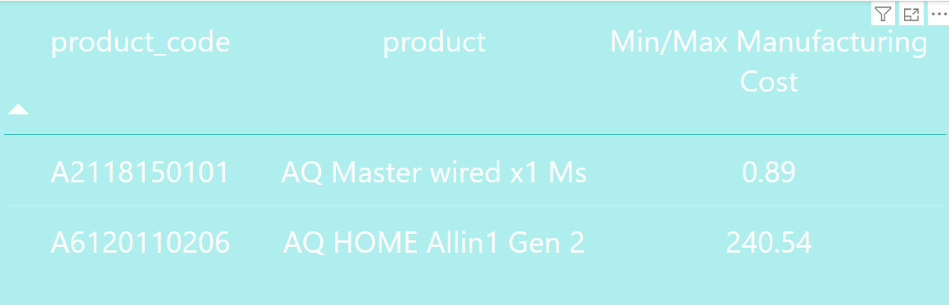
Output
Insight :
Product AQ Master wired x1 Ms has lowest manufacturing cost while AQ HOME Allin1 Gen 2 has highest manufacturing cost.

Slide 18
Request 6
Generate a report which contains the top 5 customers who received an average high pre_invoice_discount_pct for the fiscal year 2021 and in the Indian market.
Input
SELECT c.customer_code,
c.customer,
Concat(ROUND(p.pre_invoice_discount_pct*100,2), " %") AS avg_discount_pct
FROM dim_customer c JOIN fact_pre_invoice_deductions p
ON c.customer_code=p.customer_code
WHERE p.fiscal_year=2021 AND c.market="India“
ORDER BY p.pre_invoice_discount_pct DESC
LIMIT 5;
#since we have only 1 pre_invoice_discount_for a whole year there is no need to
#use AVG function at all since we want to calculate only for fiscal_year 2021

Slide 19
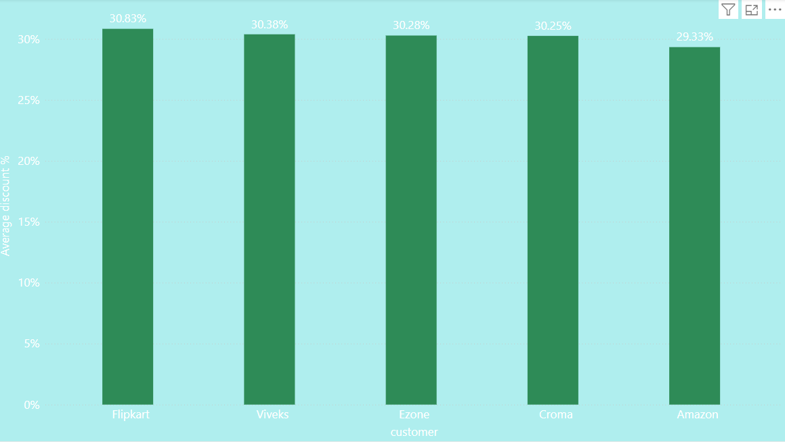
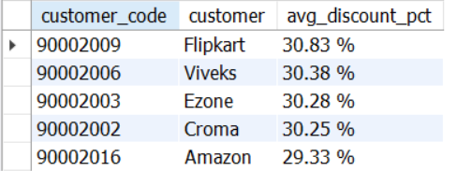
Output
Insight :
Flipkart tops the list with the highest average discount rate of 30.83%.
AtliQ has maintained fairly consistent discount rates for its top 5 customers, ranging narrowly between 29.33% and 30.83%.

Slide 20
Request 7
Get the complete report of the Gross sales amount for the customer “Atliq Exclusive” for each month . This analysis helps to get an idea of low and high-performing months and take strategic decisions.
Input
WITH CTE AS (SELECT MONTHNAME(s.date) As month,
YEAR(s.date) AS year,
ROUND(SUM(g.gross_price*s.sold_quantity)/1000000,2) AS gross_sales
FROM fact_sales_monthly s
JOIN dim_customer c
ON s.customer_code=c.customer_code
JOIN fact_gross_price g
ON s.product_code=g.product_code
AND s.fiscal_year=g.fiscal_year
WHERE c.customer="Atliq Exclusive"
GROUP BY month,year)
SELECT month,
year,
gross_sales AS gross_sales_mln FROM CTE;

Slide 21
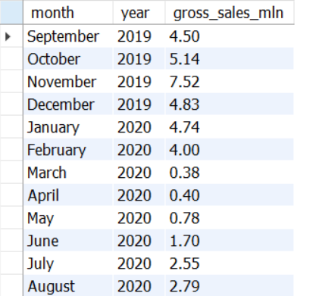
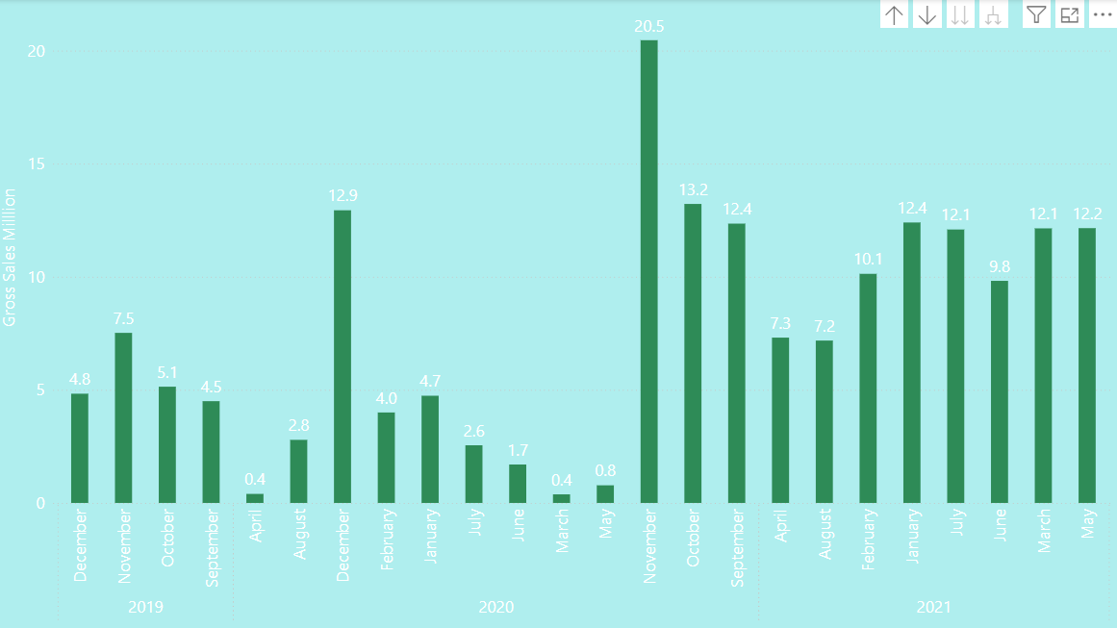
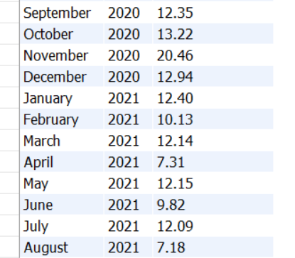
Output
Insight :
In 2020, sales were significantly impacted by the COVID-19 pandemic, with the lowest figures recorded in March, April, and May. Recovery began in June, and November marked the highest sales of the year, at 20.5 million.
Sales in 2021 were less diverse compared to 2019 and 2020, ranging between 7.2 million and 12.4 million.

Slide 22
Request 8
In which quarter of 2020, got the maximum total_sold_quantity?
Input
SELECT CONCAT("Q" ,CEILING(MONTH(DATE_ADD(date, INTERVAL 4 MONTH))/3)) AS Quarters_2020,
SUM(sold_quantity) AS total_sold_quantity
FROM fact_sales_monthly
WHERE fiscal_year=2020
GROUP BY Quarters_2020
ORDER BY total_sold_quantity DESC;

Slide 23
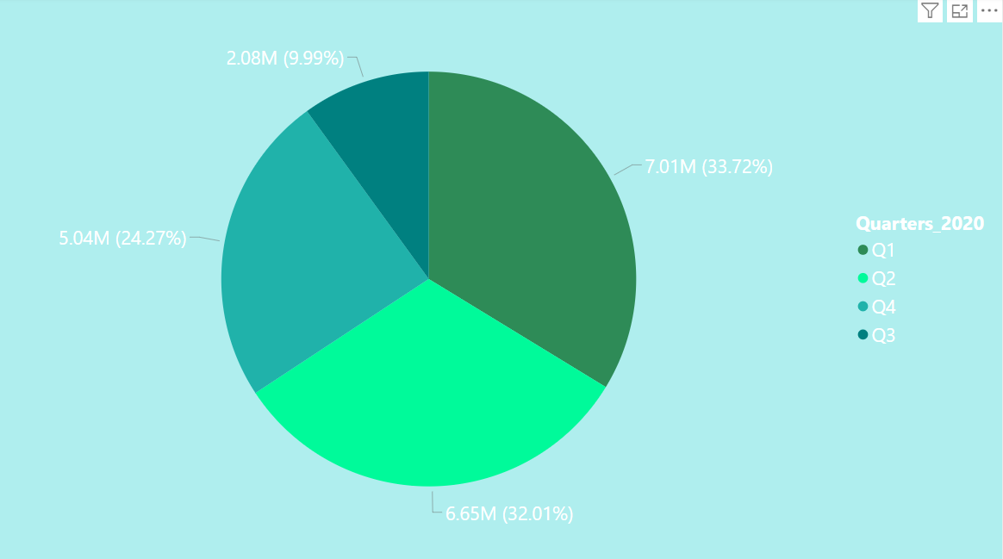
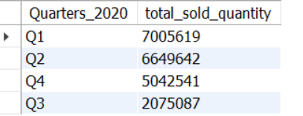
Output
Insight :
In Q1 of 2020, sales peaked at approximately 7 million units, signaling a strong start to the year.
AtliQ faced a notable drop in sales during Q3 (March, April, May), likely as a result of the COVID-19 pandemic, which mirrored the tough market conditions and changing consumer behaviors at the time.

Slide 24
Request 9
Which channel helped to bring more gross sales in the fiscal year 2021 and the percentage of contribution?
Input
WITH channel_gross_sales AS (SELECT c.channel,
ROUND(SUM(g.gross_price*s.sold_quantity)/1000000,2) AS gross_sales_mln FROM fact_sales_monthly s
JOIN dim_customer c
ON s.customer_code=c.customer_code
JOIN fact_gross_price g
ON s.product_code=g.product_code
AND s.fiscal_year=g.fiscal_year
WHERE s.fiscal_year=2021
GROUP BY c.channel)
SELECT *,
CONCAT(ROUND(gross_sales_mln*100/SUM(gross_sales_mln) OVER(),2), " %") AS percentage_contribution
FROM channel_gross_sales
ORDER BY gross_sales_mln DESC;

Slide 25
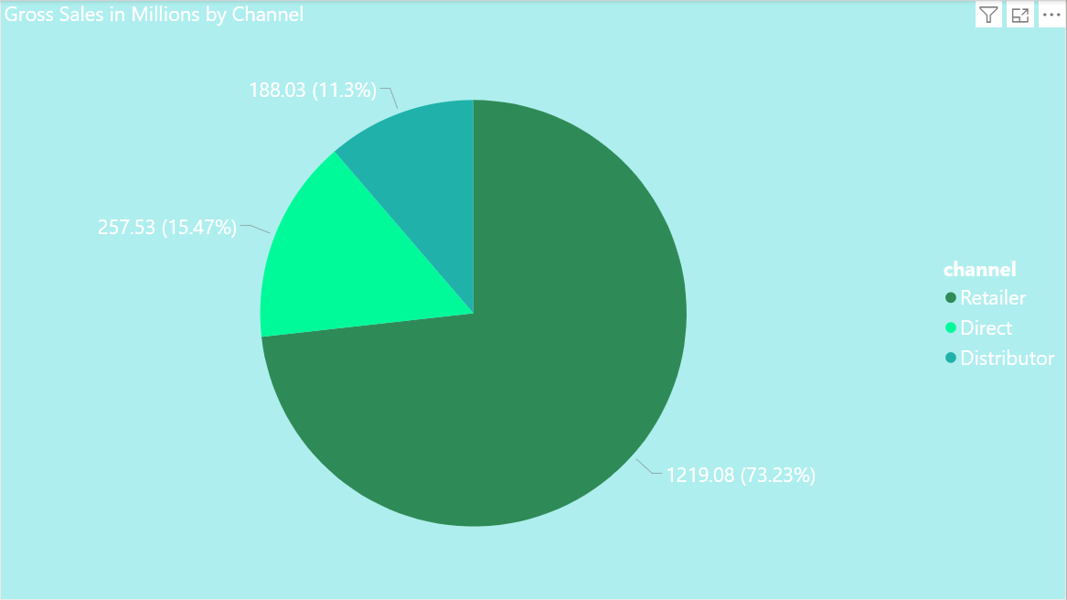
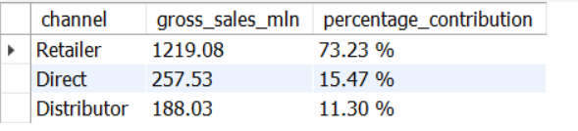
Output
Insight :
Retailers are the primary source of AtliQ's sales, contributing a significant 73.23% of the total gross sales.
The combined contribution of direct and distributor channels amounts to just 26.77% of the total sales.

Slide 26
Request 10
Get the Top 3 products in each division that have a high total_sold- _quantity in the fiscal_year 2021?
Input
WITH CTE1 AS (SELECT division,
product_code,
CONCAT(product, " | " ,variant) AS product_variant,
SUM(sold_quantity) AS total_sold_quantity
FROM dim_product
JOIN fact_sales_monthly
USING (product_code)
WHERE fiscal_year=2021
GROUP BY division, product_code, product_variant),
CTE2 AS (SELECT *,
RANK() OVER(partition by division order by total_sold_quantity DESC) AS rank_order
FROM CTE1)
SELECT *
FROM CTE2
WHERE rank_order <=3;

Slide 27
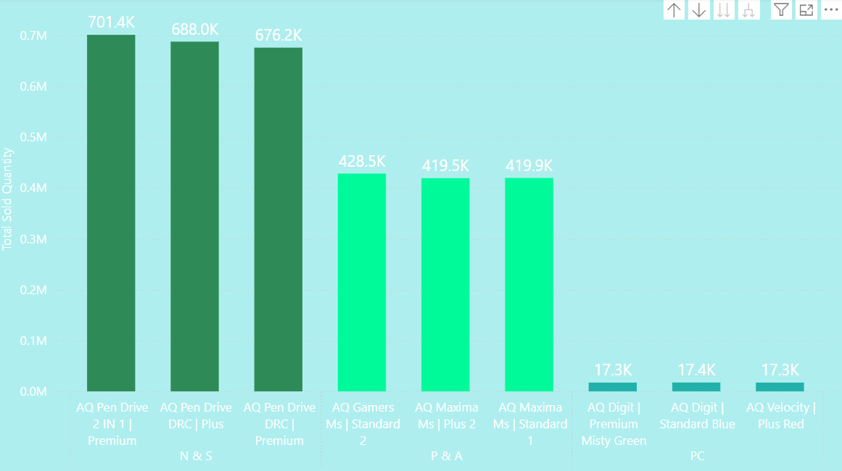
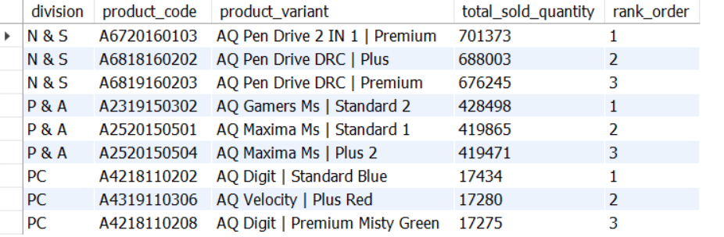
Output
Insight :
In the N & S division, pen drives occupy the top three positions, highlighting their strong popularity and impressive sales performance.
The top three products in the P & A division are all mice, indicating a clear demand for these devices.
Personal laptops are the bestsellers in the PC division, dominating the sales in this category.

Slide 28

Recommendations
Focus on desktops, storage, and networking segments to maximize revenue potential.
Implement multi-channel marketing strategies to enhance market penetration.
Combine competitive pricing with promotional campaigns to attract customers.
Leverage customer feedback to improve products and services continuously.
Invest in comprehensive sales team training to enhance performance and drive results.

Slide 29

Thank you

